Slide 1
BFX-UA300 (K18X001.00) No Boot Analysis Report
Prepared by: Do Thi Phuong
Review by: Michael
Date: May 24th 2022

Slide 2
D1. Establish the Team
Team Leader
Team Member
PE: Michael, Phuong
ME: Cheng Lun, Wen Thai
PM: Ben Zheng, An Tran
PD: Ruan Wen Yong
QA: Ken, Rachel
TE: Mark Wu, Allan Pham
IE: Hai Ly, Heng Ruan
Foxconn
  MFG Director: David Yin
  QA Manager : CB Lin, Toney

Slide 3
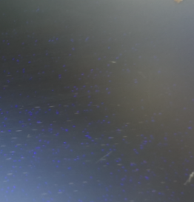
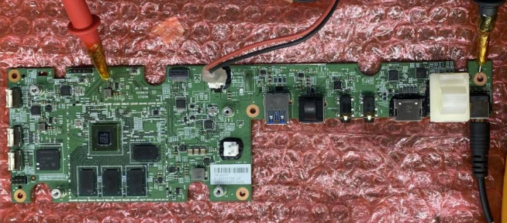
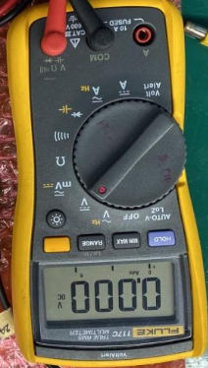
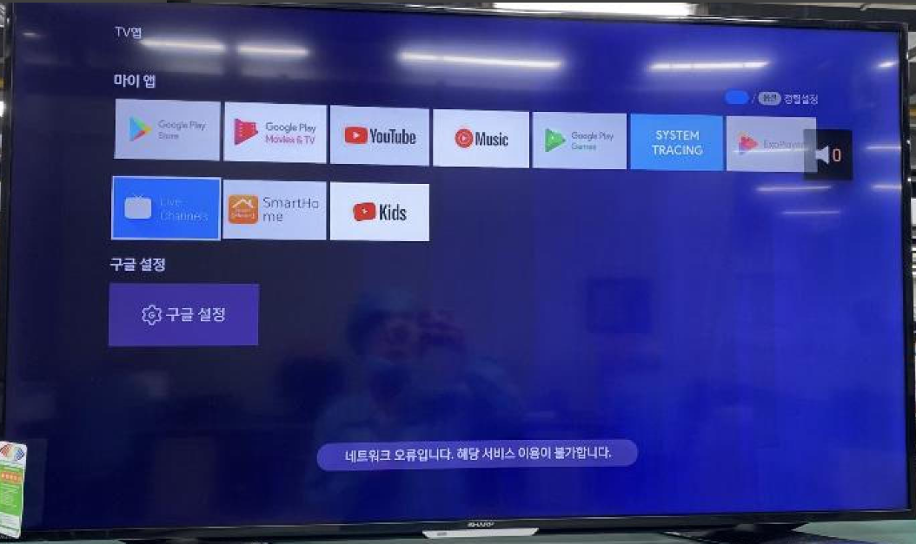
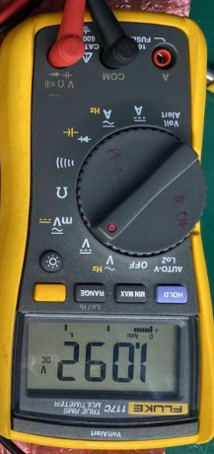
D2. Description of Problems
Issue Description
- 2022/05/05: ALT customer complaint 1pcs no boot
- Failure status: No boot_no power at U69_PWR_CORE_1V05 location.
Failure information:
Fox_SN | Cus_SN | MAC | ERROR CAUSE
YWJ0CV7 | 2149695001202201001335 | A8934AFEA65C | No boot
No boot_No power at U69
Boot up normal_U69 has power

Slide 4
D3: Containment
Recheck Boot up, Take X-ray and VI PCBA
- Check boot up→ No boot_power at U69_PWR_CORE_1V05
- Baking PCBA with 70ºC in 24 hours
- Re-check boot up→ No boot_power at U69_PWR_CORE_1V05

Slide 5
D3. Containment
Check FATP and OBA record data
FATP: NG prouduct tested pass normal at FATP
OBA: Product wasn’t tested at OBA station
SERIAL_NUMBER | MO_NUMBER | GROUP_NAME | IN_STATION_TIME | WIP_GROUP
A8934AFEA65C | 2639002209 | ASSY | 2/10/2022 10:54:14 PM | BT
A8934AFEA65C | 2639002209 | BT | 2/10/2022 11:10:08 PM | PT
A8934AFEA65C | 2639002209 | PT | 2/10/2022 11:12:44 PM | UP
A8934AFEA65C | 2639002209 | UP | 2/10/2022 11:16:37 PM | ASSY2
A8934AFEA65C | 2639002209 | ASSY2 | 2/11/2022 3:15:22 AM | ASSY3
A8934AFEA65C | 2639002209 | ASSY3 | 2/11/2022 3:19:17 AM | ASSY4
A8934AFEA65C | 2639002209 | ASSY4 | 2/11/2022 3:19:50 AM | FT1
A8934AFEA65C | 2639002209 | FT1 | 2/11/2022 3:29:47 AM | FT2
A8934AFEA65C | 2639002209 | FT2 | 2/11/2022 3:37:53 AM | FT3
A8934AFEA65C | 2639002209 | FT3 | 2/11/2022 3:39:44 AM | RC
A8934AFEA65C | 2639002209 | RC | 2/11/2022 3:41:45 AM | RC1
A8934AFEA65C | 2639002209 | RC1 | 2/11/2022 3:54:27 AM | VI
A8934AFEA65C | 2639002209 | VI | 2/11/2022 8:01:35 AM | RC2
A8934AFEA65C | 2639002209 | RC2 | 2/11/2022 8:03:49 AM | VI1
A8934AFEA65C | 2639002209 | VI1 | 2/11/2022 8:07:16 AM | PACK_BOX
A8934AFEA65C | 2639002209 | PACK_BOX | 2/11/2022 8:07:52 AM | CHECK_WEIGHT
A8934AFEA65C | 2639002209 | CHECK_WEIGHT | 2/11/2022 8:09:42 AM | PACK_CTN
A8934AFEA65C | 2639002209 | PACK_CTN | 2/11/2022 1:40:16 PM | STOCKIN
A8934AFEA65C | 2639002209 | STOCKIN | 2/11/2022 1:40:16 PM | FG
A8934AFEA65C | 2639002209 | PACK_CTN | 2/18/2022 9:23:18 AM | PACK_PALT
A8934AFEA65C | 2639002209 | PACK_PALT | 2/18/2022 2:38:11 PM | FQA
A8934AFEA65C | 2639002209 | FQA | 2/18/2022 2:45:37 PM | CHK_PALT
A8934AFEA65C | 2639002209 | STOCKIN | 2/18/2022 4:10:01 PM | FG

Slide 6
D4. Root Cause
1. Check power supply on main board
- Measure power supply find out NG product no power at U69_PWR_CORE_1V05 location.
No boot_No power at U69
Boot up normal_U69 has power
Summary:
- With NG board, checked boot up fail did not have HDMI output, no power at U69_PWR_CORE_1V05.

Slide 7
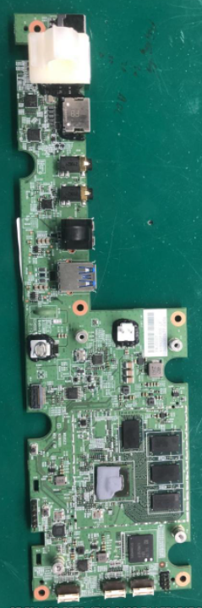
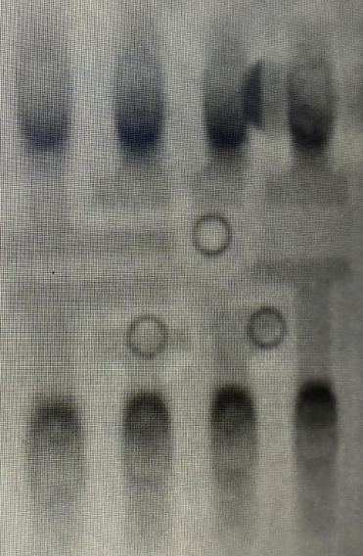
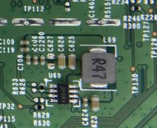
D4. Root Cause
2. Visual Inspection and X-Ray
Visual inspection.
- Visual inspection at U69 block, didn’t see any abnormal at U69 block
Take X-ray
- X-ray U69 location, didn’t find out short solder, dewetting, no solder issue,…
VI U69 power block Side
Power IC (U69) location
Summary:
- Visual inspection and X-ray are normally

Slide 8
D4. Root Cause
3. Voltage Of U69 Measurement On Board
- Measure voltage at all pin of NG U69 and compare with OK sample
Location | Pin Description | Ok sample | U69 NG sample | Result
 |  | Volt(V) | Volt(V)
Pin 1_GND | Ground pin. | 0 | 0 | Normal
Pin 2_RST | Pulling this pin high will reset the register to default value. | 0 | 0 | Normal
Pin 3_EN | Enable control pin | 3.326 | 3.326 | Normal
Pin 4_FBS | Feedback pin | 1.076 | 0 | Abnormal
Pin 5_SDA | Data line for the I2C interface. Open-drain output. | 3.31 | 3.309 | Normal
Pin6_SCL | Clock input for the I2C interface. Open-drain input. | 3.31 | 3.309 | Normal
Pin 7_PVIN | Power input pin | 4.985 | 4.985 | Normal
Pin 8_LX | Switching node pin. | 1.091 | 0 | Abnormal
Summary:
- NG U69 has Pin 4_FBS, Pin 8_LX no power

Slide 9
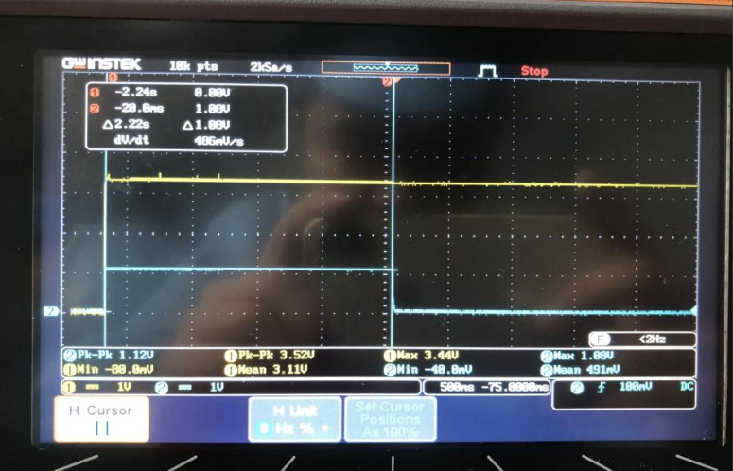
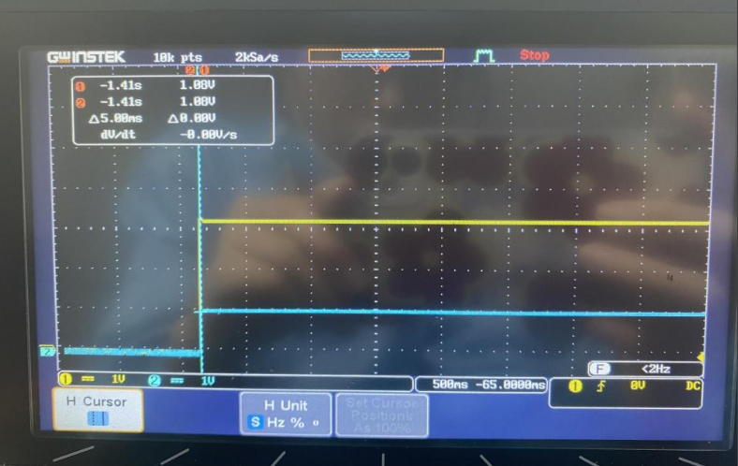
D4. Root Cause
4. U69 Power Measurement By Osilloscope
Power measurement of U69_PWR_CORE_1V05
PWR_3V3
PWR_3V3
PWR_CORE_1V05
PWR_CORE_1V05
U69_NG
U69_OK
Summary:
- NG U69_PWR_CORE_1V05 power only has during 2.22s then lose

Slide 10
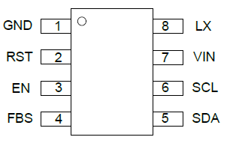
D4. Root Cause
5. U69 Impedance & Voltage Diode Measurement after removed
- Remove U69 from PCBA then measure impedance and voltage diode
No# | Pin Name | Pin Description | OK sample |  | U69 NG sample
 |  |  | Impedance (Ω) | VF voltage (VD) | Impedance (Ω) | VF voltage (VD)
1 | Pin 1_GND | Ground pin. | 0 | 0 | 0 | 0
2 | Pin 2_RST | Pulling this pin high will reset the register to default value. | 2.918M | 0.585 | 2.815M | 0.567
3 | Pin 3_EN | Enable control pin | 2.914M | 0.584 | 2.820M | 0.567
4 | Pin 4_FBS | Feedback pin | 0.665M | 0.666 | 0.688M | 0.685
5 | Pin 5_SDA | Data line for the I2C interface. Open-drain output. | 2.854M | 0.578 | 2.756M | 0.572
6 | Pin6_SCL | Clock input for the I2C interface. Open-drain input. | 2.915M | 0.585 | 2.805M | 0.577
7 | Pin 7_PVIN | Power input pin | 2.701M | 0.529 | 2.594M | 0.546
8 | Pin 8_LX | Switching node pin. | 1.354M | 0.337 | 1.220M | 0.361
Pinout (top view)
Summary:
- U69(SY8824CA) NG sample check impedance and voltage diode normally

Slide 11
D4. Root Cause
6. Change new U69(SY8824CA)
- Changed new U69 then check power.
After change new U69
Location | Pin Description | Before change U69 | After change U69
 |  | Volt(V) | Volt(V) | Result
Pin 1_GND | Ground pin. | 0 | 0 | Normal
Pin 2_RST | Pulling this pin high will reset the register to default value. | 0 | 0 | Normal
Pin 3_EN | Enable control pin | 3.326 | 3.32 | Normal
Pin 4_FBS | Feedback pin | 0 | 1.07 | Normal
Pin 5_SDA | Data line for the I2C interface. Open-drain output. | 3.309 | 3.31 | Normal
Pin6_SCL | Clock input for the I2C interface. Open-drain input. | 3.309 | 3.31 | Normal
Pin 7_PVIN | Power input pin | 4.985 | 4.98 | Normal
Pin 8_LX | Switching node pin. | 0 | 1.09 | Normal
PWR_3V3
PWR_CORE_1V05
PWR_CORE_1V05
Summary:
- After change new U69_SA8824CA, NG product has PWR_CORE_1V05 normal at U69 .

Slide 12
D4. Root Cause
7. Swap Verification
U69 swap verification
- Swap verification between NG U69 and OK U69, received result as table.
Item | Result
OK board + OK U69 | OK
NG board + NG U69 | NG
OK board + NG U69 | NG
NG broad + OK U69 | OK
Summary:
- As analysis above this issue follow U69(SY8824CA)_ P/N: 029.00909.005 component.

Slide 13
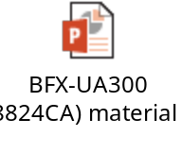
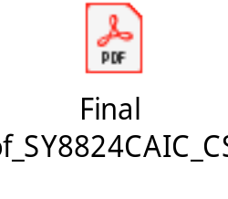
Conclusion
1. Summary for root cause
Root cause:
- As analysis above this issue follow U69(SY8824CA)_ P/N: 029.00909.005 component
- Send material and report to SQE: Mr. Ha. Done: 2022/05/17
Need SQE send U69 (P/N: 029.00909.005) component to SILERGY vendor for further analysis. Due date: 2022/05/30. Done
SILERGY vendor updated the final report on 07/13/2022.
See an attachment file below. ( Attachment file 1 is Fii FA report, Attachment file 2 is SILERGY vendor FA report.

